Slide 1


Titolo presentazione sottotitolo
Software Engineering for Automation
Iqueue Project
Andrea Gottardini, Gianluca Giacomelli, Niccolò Enrico Veronese
Milano, XX mese 20XX

Slide 2
Content
𝙸𝚚𝚞𝚎𝚞𝚎
1. Feasibility study
2. Requirement analysis
3. Design analysis
4. Implementation
5. Testing
UML requirements
UML architectural
Giacomelli, Gottardini, Veronese

Slide 3


Feasibility study
𝙸𝚚𝚞𝚎𝚞𝚎
𝙸𝚚𝚞𝚎𝚞𝚎
Giacomelli, Gottardini, Veronese

Slide 4
Content
𝙸𝚚𝚞𝚎𝚞𝚎
1. Feasibility study
2. Requirement analysis
3. Design analysis
4. Implementation
5. Testing
UML requirements
UML architectural
Giacomelli, Gottardini, Veronese

Slide 5





Feasibility study
𝙸𝚚𝚞𝚎𝚞𝚎
Feasibility Study helps to objectively decide whether to proceed with a proposed project or not.
Description of Application Function and Goals
Technology Considerations
Product Service Marketplace
Customers can see the queue
Shop owners can advertise the shops
QR code based
Pyhton Django
QR code reading
GPS system
The global queue management systems in terms of revenue was $0.5 billion in 2020
PostCovid Growth
Giacomelli, Gottardini, Veronese

Slide 6

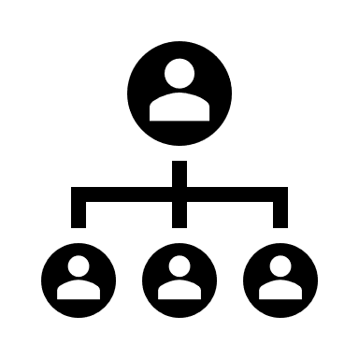
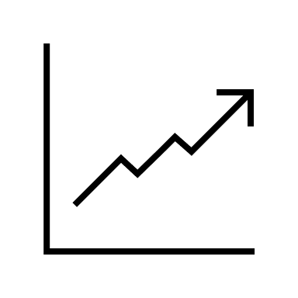
Feasibility study
𝙸𝚚𝚞𝚎𝚞𝚎
Marketing Strategy
Organization and Staffing
Financial Projections
Focus on small/medium companies
Gain for both Customer and Shop owners
Social media campaign
App development manager
Sales and Marketing Manager
Customer Support Representative
In-app purchases
In-app advertising
Freemium
Giacomelli, Gottardini, Veronese

Slide 7
Requirement analysis
𝙸𝚚𝚞𝚎𝚞𝚎
𝙸𝚚𝚞𝚎𝚞𝚎
Giacomelli, Gottardini, Veronese

Slide 8
Content
𝙸𝚚𝚞𝚎𝚞𝚎
1. Feasibility study
2. Requirement analysis
3. Design analysis
4. Implementation
5. Testing
UML requirements
UML architectural
Giacomelli, Gottardini, Veronese

Slide 9
Requirements Analysis (RASD)
𝙸𝚚𝚞𝚎𝚞𝚎
A RASD is a document that aims to present all the requirements of the system to be developed, explaining the domain in which it has to operate and what the application will do in a detailed way.
Goal
Product functions
Elicitation of requirements
Specific requirements
Giacomelli, Gottardini, Veronese

Slide 10
Requirements Analysis (RASD) - Goal
𝙸𝚚𝚞𝚎𝚞𝚎
Goal
Customer
View the current queue status for the shop
Shop Owner
Better forecast and plan their inventory and staffing needs based on the expected footfall of customers
Book time slots
Get discounts or other benefits by using the Iqueue app
Provide feedback and ratings for the shops
Search and discover new shops based on their preferences and location
Improve the brand awareness and visibility
Offer personalized promotions
Build customer loyalty
Access analytics and insights on their business performance
Giacomelli, Gottardini, Veronese

Slide 11



Requirements Analysis (RASD) – Product Function
𝙸𝚚𝚞𝚎𝚞𝚎
Product Function
Data collection
Customer information (name, email, birthday, password, location,..)
Data analysis
Associate the booking with the time slot and the queue
Shop Owner information (shop, product, advertisement, special offers)
Inc/dec system
Associate the Inc/dec system with the queue
Associate the Shop Owner info to the correspoding Shop
QR code reading and generating
GPS system connection
Giacomelli, Gottardini, Veronese

Slide 12
Requirements Analysis (RASD) – Elicitation of requirements
𝙸𝚚𝚞𝚎𝚞𝚎
Elicitation of requirements
Stakeholders
People with a smartphone willing to go in a Shop
Existing systems
Qminder: high price, big companies, supermarkets
People who own a small/medium Shop
GPS systems
Waitwhile: low price, no Map/GPS interface
Qwaiting: QR code based, high price
People must know how to use a smartphone (download an App) and how to scan a QR code
Giacomelli, Gottardini, Veronese

Slide 13
Requirements Analysis (RASD) – Elicitation of requirements
𝙸𝚚𝚞𝚎𝚞𝚎
Elicitation of requirements
Scenarios: a narrative description of what people do and experience as they try to make use of computer systems and applications. From the scenarios general Use cases can be derived and they are analysed considering the following features:
Actors: Iqueue, Client, Shop Owner, GPS system
Entry Condition
Flow of Events
Exit Condition
Exceptions
Special Requirements
Scenarios
Difficulties in finding the pastries for the party
Difficulties in counting the visitors
Poor number of clients
New in town
Giacomelli, Gottardini, Veronese

Slide 14
Requirements Analysis (RASD) – From scenarios to use cases
𝙸𝚚𝚞𝚎𝚞𝚎
Scenario
Actors
Client, Shop Owner, Iqueue, GPS system
Entry Condition
A long queue outside a shop
Flow of Events
The Client selects a certain type of shops (bakeries in the scenario).
Iqueue show on his map a list of the available shops of the indicated type with their queues.
The Client selects a shop.
Iqueue shows the available products, time slots and special offers.
The Client scans the products and select a free time slot.
Iqueue notifies the Shop Owner of the time slot booking.
The Client chooses to be guided to the shop.
Iqueue redirects the Client to a third-party GPS system and provides to it the shop address.
Exit Condition
The Client is guided by the GPS system. The selected time slot is now unavailable to any other Client. The client receives the QR code with the booked time slot.
Special Requirements
The queue of a shop has not to exceed in time the opening hours of the shop, otherwise the time slot is unavailable. The Client must have a GPS system on his device
Difficulties in finding the pastries for the party
Use Case
Book
Giacomelli, Gottardini, Veronese

Slide 15
Requirements Analysis (RASD) – From scenarios to use cases
𝙸𝚚𝚞𝚎𝚞𝚎
Scenario
Actors
Client, Shop Owner, Iqueue
Entry Condition
Client enters in a shop
Flow of Events
Shop Owner asks the Client if he has done a reservation with Iqueue.
Exit Condition
The use case terminates after the increment of the client counter. Shop Owner can consult the client counter value on different shop opening accessing Iqueue.
Exceptions
If the Client has not done his registration on Iqueue, the Shop Owner increments the client counter on Iqueue by himself with the inc/dec system.
The Shop Owner scans the client QR code.
Iqueue increments the counter client for the shop of the relative shop opening.
Difficulties in counting the visitors
Use Case
Count clients
Giacomelli, Gottardini, Veronese

Slide 16
Requirements Analysis (RASD) – From scenarios to use cases
𝙸𝚚𝚞𝚎𝚞𝚎
Scenario
Actors
Shop Owner, Iqueue
Entry Condition
Shop Owner has a shop
Flow of Events
Shop Owner starts register Shop procedure on Iqueue.
Exit Condition
The use case terminates after the product discounts entering. Shop registration is now terminated, and the shop is now visible on the Iqueue map with its products.
Exceptions
The insertion of shop position and products is mandatory to conclude the shop registration on Iqueue; The Shop Owner could not insert immediately pictures, the logo of his shop and the special offers on products to register his shop. They could be inserted in a second moment.
Iqueue asks shop position to the Shop Owner.
Shop Owner inserts the shop position.
Iqueue asks shop logo and/or pictures to the Shop Owner.
Shop Owner inserts the shop logo and/or pictures (optional).
Iqueue asks Shop Owner to insert products of his shop.
Shop Owner inserts the products.
Iqueue asks Shop Owner to insert special offers on products.
Shop Owner inserts the special offers on products (optional).
Poor number of clients
Use Case
Register shop
Giacomelli, Gottardini, Veronese

Slide 17
Requirements Analysis (RASD) – From scenarios to use cases
𝙸𝚚𝚞𝚎𝚞𝚎
Scenario
Actors
Client, Iqueue
Entry Condition
Client likes to know shops in his surroundings
Flow of Events
Client allows Iqueue to know his position.
Exit Condition
The use case terminates after the Iqueue shows the products and special offers. Client could now book a time slot or simply exit the application.
Special Requirements
The Client must have a device which is able to provide the position to the Iqueue.
Client selects a certain type of shops.
Iqueue show on his map a list of the available shops of the indicated type with their queues.
Client selects a maximum distance from the shops.
Iqueue shows the shops accordingly with the selected distance.
The Client selects a shop.
Iqueue shows the available products and special offers.
New in town
Use Case
Search
Giacomelli, Gottardini, Veronese

Slide 18
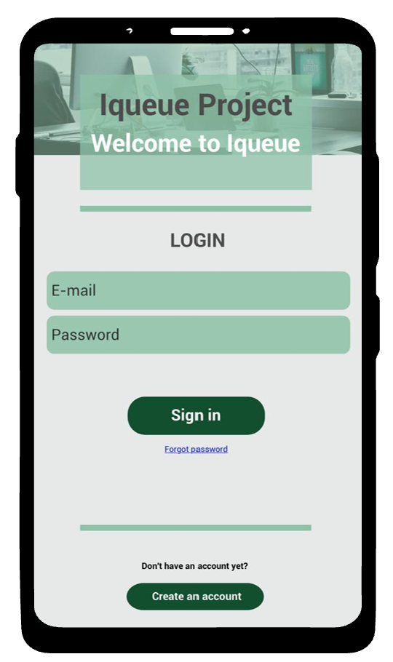
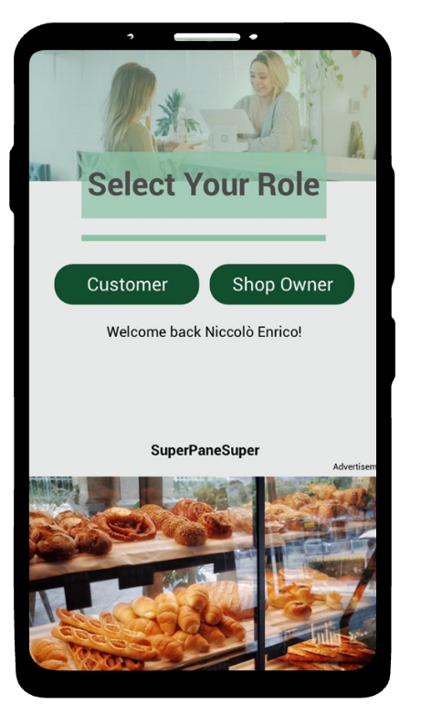
Requirements Analysis (RASD) – Specific requirements
𝙸𝚚𝚞𝚎𝚞𝚎
Specific requirements
External interfaces – User interfaces
1. Initial page of the system
2. Select your role page
Giacomelli, Gottardini, Veronese

Slide 19
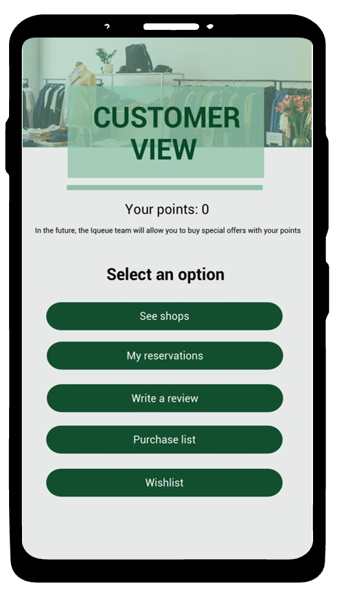
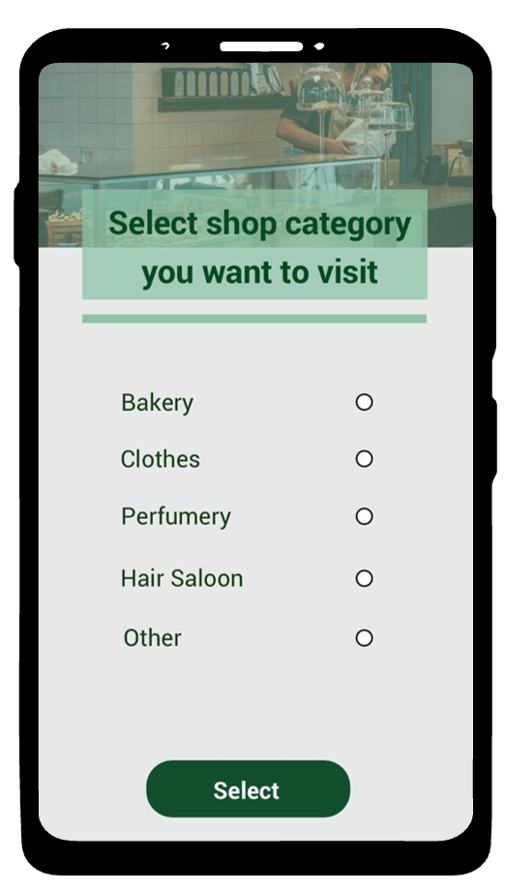
Requirements Analysis (RASD) – Specific requirements
𝙸𝚚𝚞𝚎𝚞𝚎
Specific requirements
External interfaces – Customer interfaces
1. Customer view
2: Select shop category view
Giacomelli, Gottardini, Veronese

Slide 20
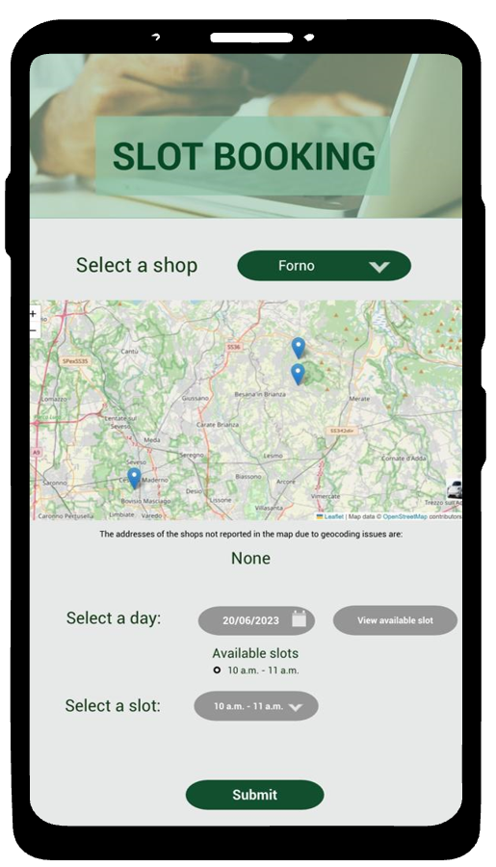
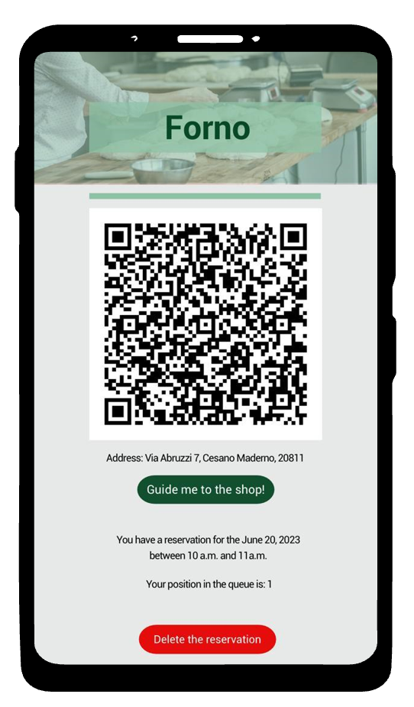
Requirements Analysis (RASD) – Specific requirements
𝙸𝚚𝚞𝚎𝚞𝚎
Specific requirements
External interfaces – Customer interfaces
3. Slot booking view
4: My reservation view
Giacomelli, Gottardini, Veronese

Slide 21
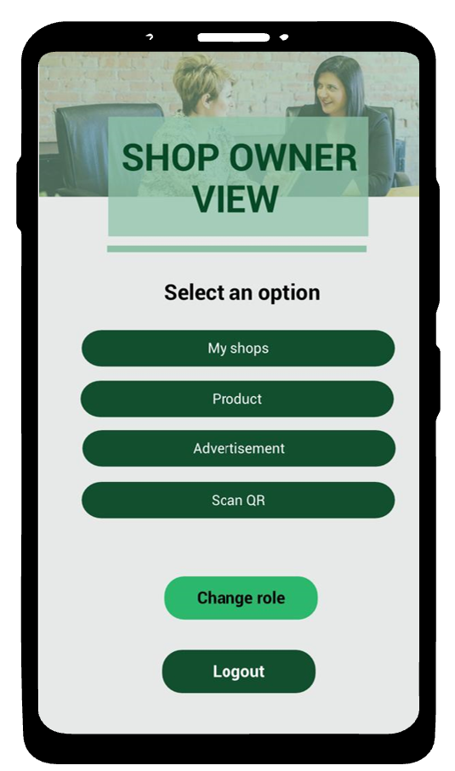
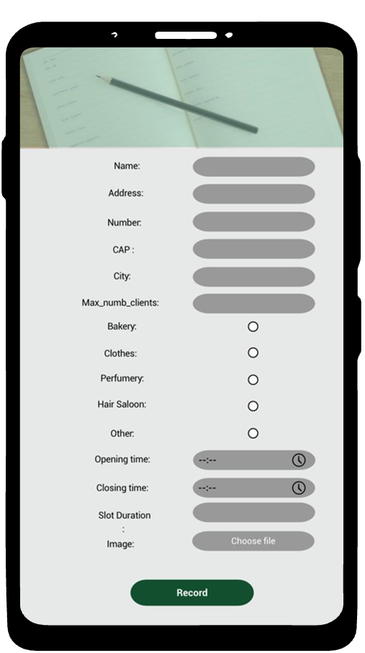
Requirements Analysis (RASD) – Specific requirements
𝙸𝚚𝚞𝚎𝚞𝚎
Specific requirements
External interfaces – Shop owner interfaces
1. Shop owner view
2. Register Shop page
Giacomelli, Gottardini, Veronese

Slide 22
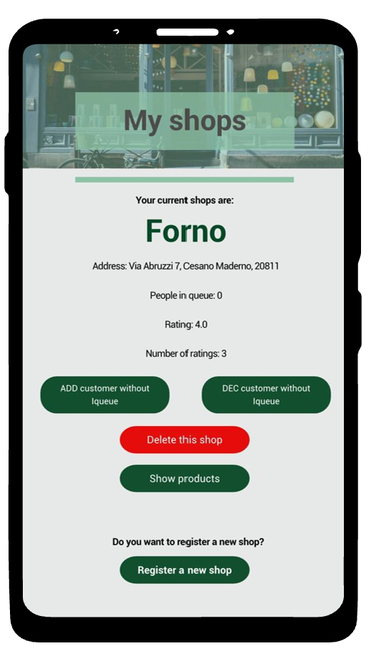
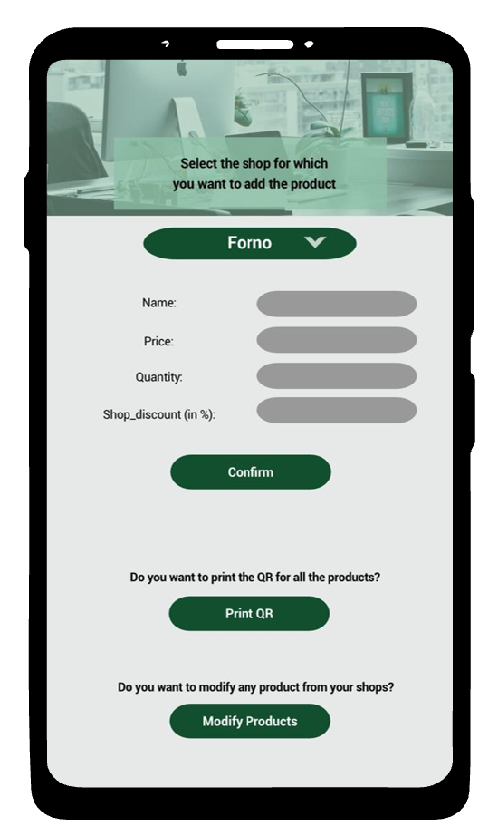
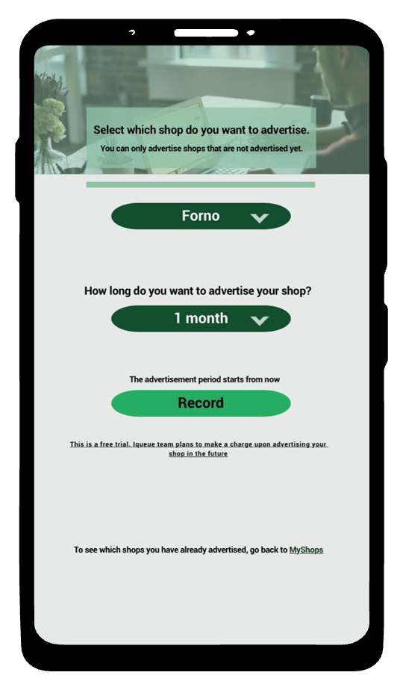
Requirements Analysis (RASD) – Specific requirements
𝙸𝚚𝚞𝚎𝚞𝚎
Specific requirements
External interfaces – Shop owner interfaces
3. My Shops view
4. Register product page
5. Register advertisement page
Giacomelli, Gottardini, Veronese

Slide 23
Requirements Analysis (RASD) – Specific requirements
𝙸𝚚𝚞𝚎𝚞𝚎
Specific requirements
 | REQUIREMENTS
R1 | Iqueue must allow the customers to see the number of people in the queue at a specific shop
R2 | Iqueue shall allow the shop owners to insert the data of their activity
R3 | Iqueue shall allow the shop owners to insert special offers for their shop
R4 | Iqueue must read the QR code of the clients with the app
R5 | The app shall allow customers to track their rewards
R6 | Iqueue must allow a customer to book a time slot on the app to visit the shop
R7 | Iqueue must keep track of the customer position
R8 | Iqueue allow the shop owner to associate a mean time for every person in the queue.
R9 | Iqueue calculates the waiting time of a customer, based on the mean time for every person in the queue.
R10 | The app shall allow customers to create and save shopping lists or wish lists.
Giacomelli, Gottardini, Veronese

Slide 24
Requirements Analysis (RASD) – Specific requirements
𝙸𝚚𝚞𝚎𝚞𝚎
Specific requirements
 | REQUIREMENTS
R11 | The app shall show the customer's purchase history and receipts
R12 | The app will be able to divide the registered facilities into categories
R13 | The app will permit the shop owner to insert their products/services
R14 | The app will enable shop owners to insert the price of their products/services
R15 | The app will enable shop owners to modify the price of their products/services
R16 | Iqueue must be able to generate the client QR code
R17 | Iqueue must show the available time slots of a shop
R18 | Iqueue must permit a customer to delete his booked time slot
R19 | The app will show the registered shops on a map/list
R20 | Iqueue shall allow the shop owners to modify the data of their activity
Giacomelli, Gottardini, Veronese

Slide 25
Requirements Analysis (RASD) – Specific requirements
𝙸𝚚𝚞𝚎𝚞𝚎
Specific requirements
 | REQUIREMENTS
R21 | Iqueue shall permit the shop owners to delete the data of their activity
R22 | Iqueue shall allow the shop owners to modify special offers for their shop
R23 | Iqueue shall allow the shop owners to delete special offers for their shop
R24 | The app must be able to track customer rewards and loyalty points
R25 | Iqueue must allow user registration
R26 | Iqueue must allow the user to operate as customer or as shop owner
R27 | Iqueue must allow log-in as customer
R28 | Iqueue must allow log-in as shop owner
R29 | Iqueue must allow log-out
R30 | The app will enable shop owners to remove their products/services
Giacomelli, Gottardini, Veronese

Slide 26
Requirements Analysis (RASD) – Specific requirements
Specific requirements
 | REQUIREMENTS
R31 | The app will enable shop owners to count their available products/services
R32 | Iqueue will be able to realize to queue counting by means of the QR codes
R33 | Iqueue will allow the shop owner to manually increment or decrement the queue counter
R34 | Iqueue shall allow the customer to select the category of the shops he is interested to visit
R35 | Iqueue shall allow the customer to select a specific shop
R36 | Iqueue shall allow the customer to select a specific shop product/service
R37 | Iqueue establishes counters to keep track of the client visits during the shops opening hours.
R38 | The app shall allow the shop owner to advertise their shop
R39 | The app shows the user of the interested queue variation
R40 | Iqueue shall give the shop address to a third-party GPS system to guide the client to the shop
R41 | Iqueue will allow the client to provide feedback and rating to the shops
Giacomelli, Gottardini, Veronese

Slide 27
Content
𝙸𝚚𝚞𝚎𝚞𝚎
Feasibility study
Requirement analysis
Design analysis
Implementation
Testing
UML requirements
UML architectural
Giacomelli, Gottardini, Veronese

Slide 28
UML requirements
𝙸𝚚𝚞𝚎𝚞𝚎
UML Requirements provides a detailed report of the UML class diagram of our Iqueue project. In this document a description of the main functionality of our app is present, together with an explanation of the classes, attributes, and methods of each component of it.
Classes
Methods
Sequence diagrams
Giacomelli, Gottardini, Veronese

Slide 29
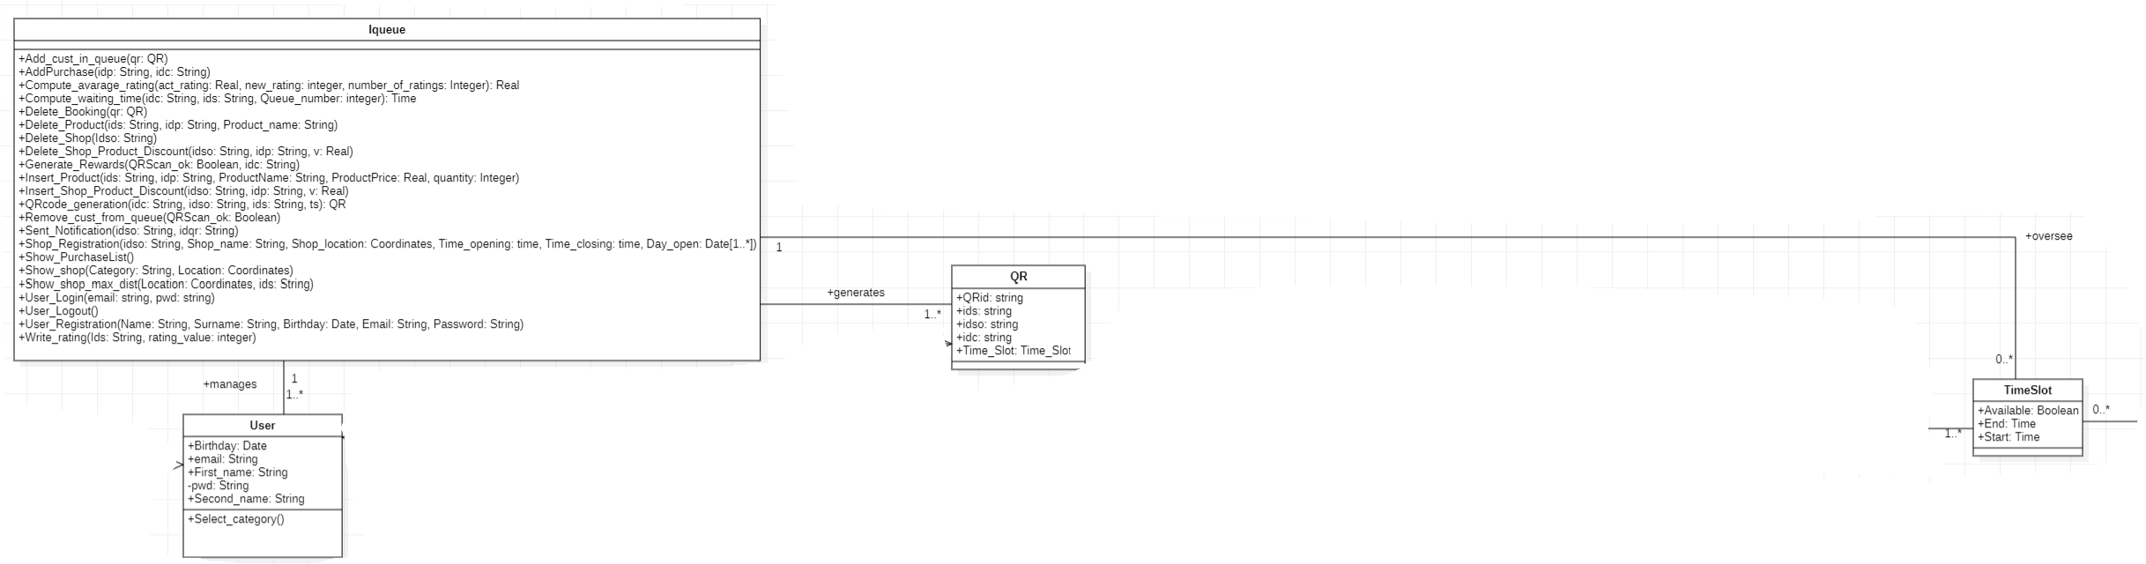
UML requirement - Classes
𝙸𝚚𝚞𝚎𝚞𝚎
Classes
Iqueue class: It has no attributes, but many methods which represent the operations which have to be performed by the WebApp. It is connected via association with the User class, with the TimeSlot class and with the QR code class.
Giacomelli, Gottardini, Veronese

Slide 30
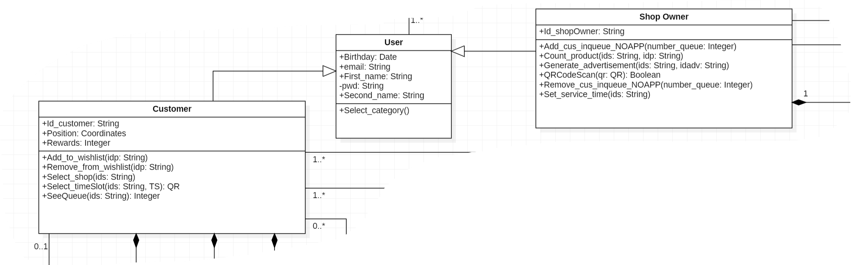
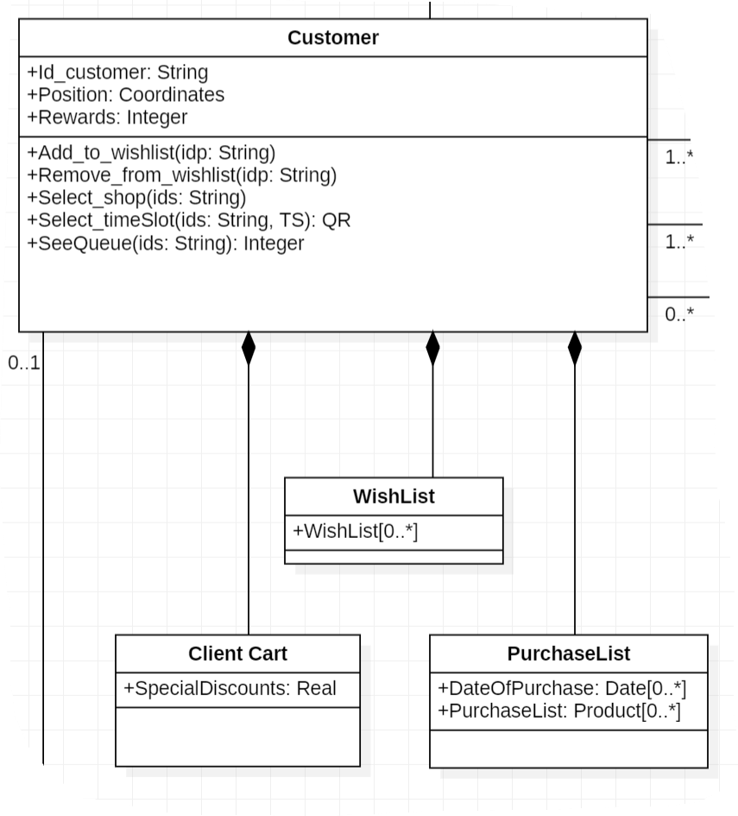
UML requirement - Classes
𝙸𝚚𝚞𝚎𝚞𝚎
User class:
User of the Iqueue app
Generalization of Customer and Shop owner
Customer class:
Attributes like position and rewards
It has compositions like Wishlist, Purchase list and Client cart
Characterized by idc
Connected to TimeSlot class to generate the bookings
Giacomelli, Gottardini, Veronese

Slide 31
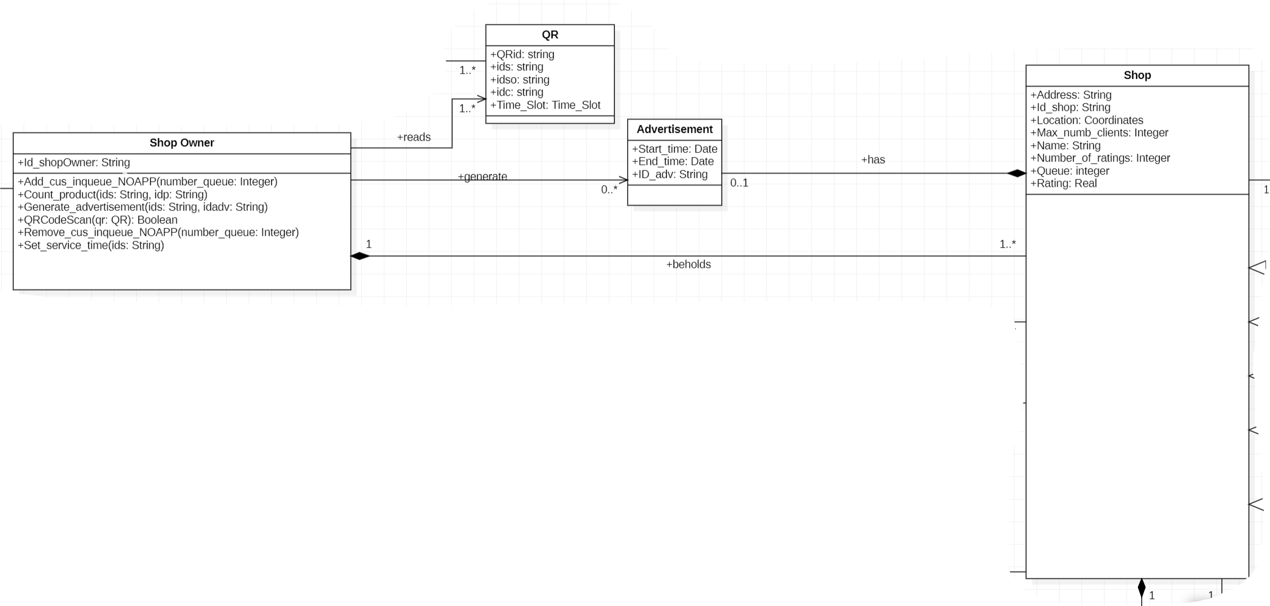
UML requirement - Classes
𝙸𝚚𝚞𝚎𝚞𝚎
QR class:
Connected to Shop Owner and Iqueue
Characterized QRid
Shop Owner class:
Characterized by idso
Advertisement class:
Characterized by idadv
It has a start and a finish date
Giacomelli, Gottardini, Veronese

Slide 32
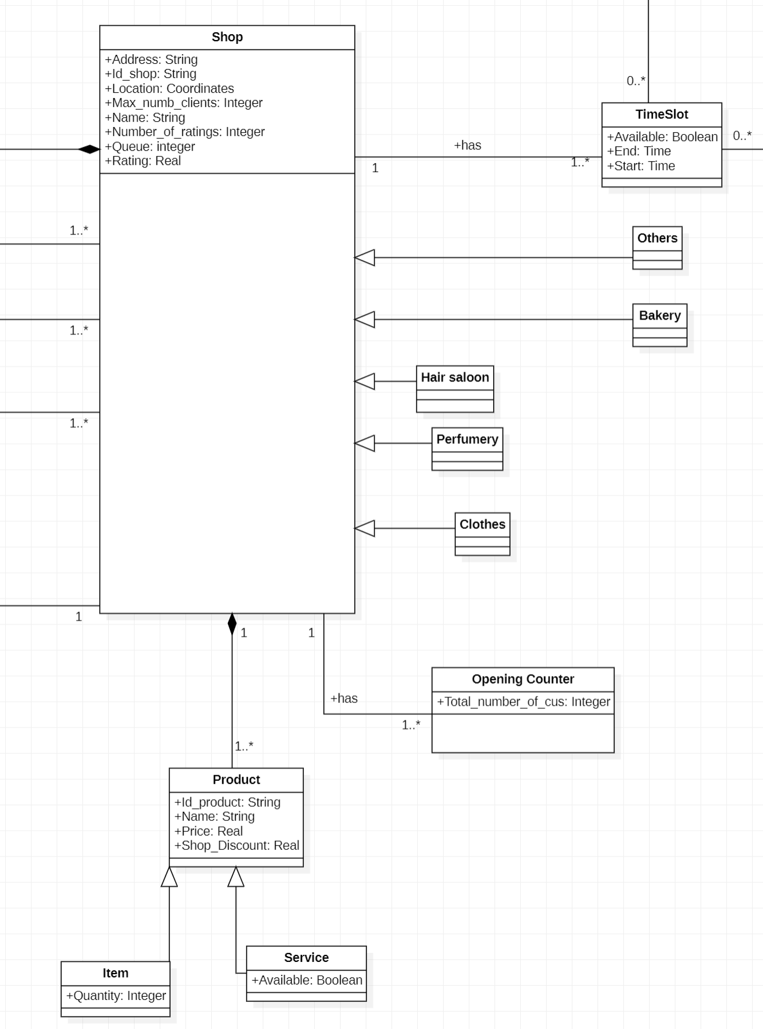
UML requirement - Classes
𝙸𝚚𝚞𝚎𝚞𝚎
Shop class:
Characterized by ids
Many attributes like address, location, max_numb_clients,
queue, rating, etc.
Product is its composition
It is a generalization of the different shop categories
Product class:
Composition of the Shop
Characterized by idp
Generalization of Item and Service
Time slot class:
Represents the mean with which the Customer can make his reservation in the Shop
Connected to Shop (each Shop has its own TimeSlot) and to Customer
Giacomelli, Gottardini, Veronese

Slide 33
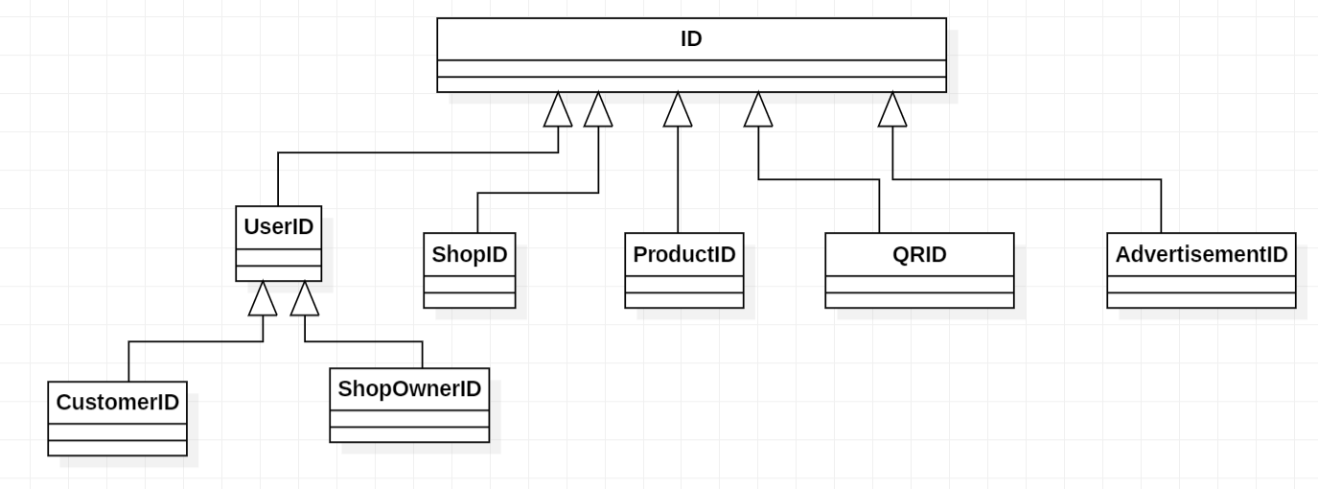
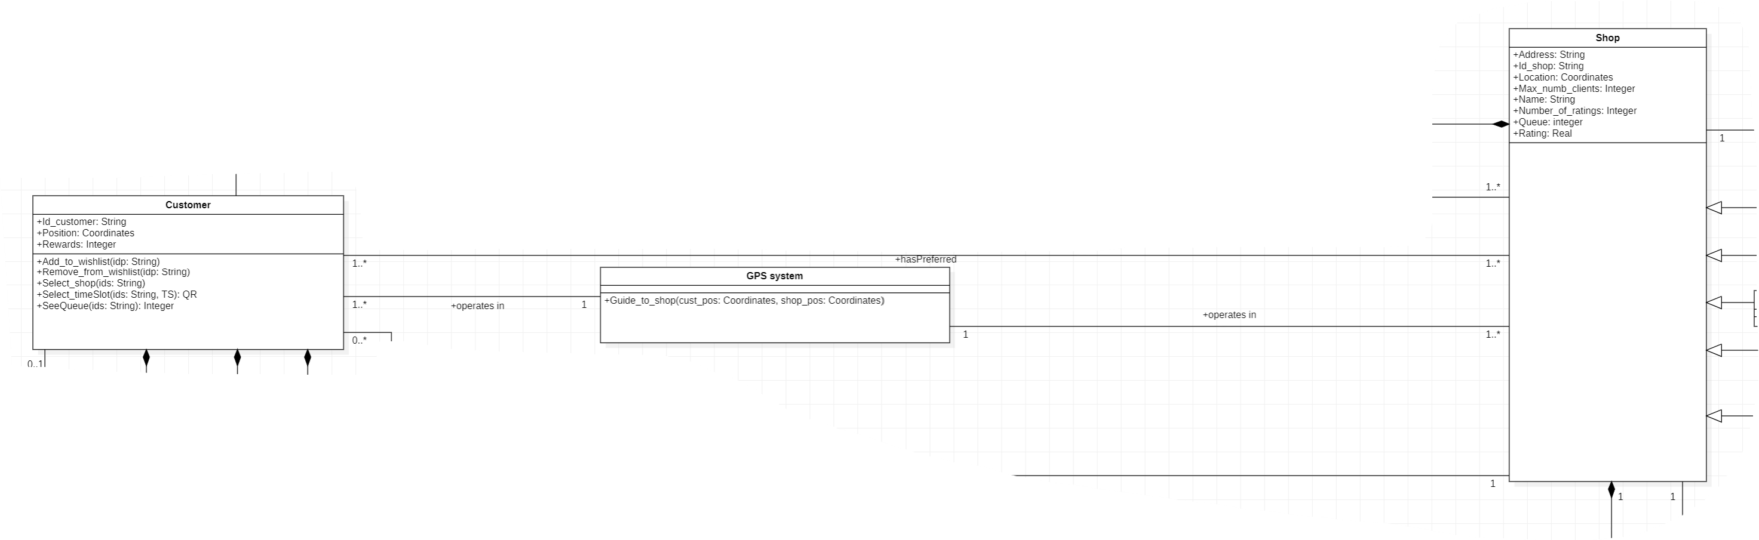
UML requirement - Classes
𝙸𝚚𝚞𝚎𝚞𝚎
ID class:
Useful to represent better the relationships among classes in the methods
GPS system class:
Connect the Customer with the Shop
Giacomelli, Gottardini, Veronese

Slide 34
UML requirement - Methods
𝙸𝚚𝚞𝚎𝚞𝚎
Methods
Iqueue Methods
User_registration(in Name:String, in Surname:String, in Birthday:Date, in Email:String, in Password:String)
Insert_Product(in ids:String, in idp:String, in ProductName:String, in ProductPrice:Real, in quantity:Integer)
User_login(in email:string, in pwd:string)
Shop_registration(in idso:String, in Shop_name:String, in Shop_location:Coordinates, in Time_opening:time, in Time_closing:time, in Day_open:Date[1..*])
QRcode_generation(in idc:String, in idso:String, in ids:String, in ts:TimeSlot): QR
Add_cust_in_queue(in qr:QR)
Show_shop(in Category:String, in Location:Coordinates)
Generate_rewards(in QRScan_ok:Boolean, in idc:String)
Write_rating(in Ids:String, in rating_value:integer)
Compute_avarage_rating(in act_rating:Real, in new_rating:integer, in number_of_ratings:Integer): Real
Giacomelli, Gottardini, Veronese

Slide 35
UML requirement - Methods
𝙸𝚚𝚞𝚎𝚞𝚎
User Methods
Select_category()
Customer Methods
Select_shop(in ids:String)
Select_timeSlot(in ids:String, in TS:TimeSlot): QR
SeeQueue(in ids:String): Integer
Add_to_wishlist(in idp:String)
Remove_from_wishlist(in idp:String)
Giacomelli, Gottardini, Veronese

Slide 36
UML requirement - Methods
𝙸𝚚𝚞𝚎𝚞𝚎
GPS System Method
Guide_to_shop(in cust_pos:Coordinates, in shop_pos:Coordinates)
Shop Owner Methods
QRCodeScan(in qr:QR): Boolean
Insert_product_discount(in idp:string, in v:Real): string
Add_cus_inqueue_NOAPP(in number_queue:Integer)
Remove_cus_inqueue_NOAPP(in number_queue:Integer)
Generate_advertisement(in ids:String, in idadv:String)
Giacomelli, Gottardini, Veronese

Slide 37
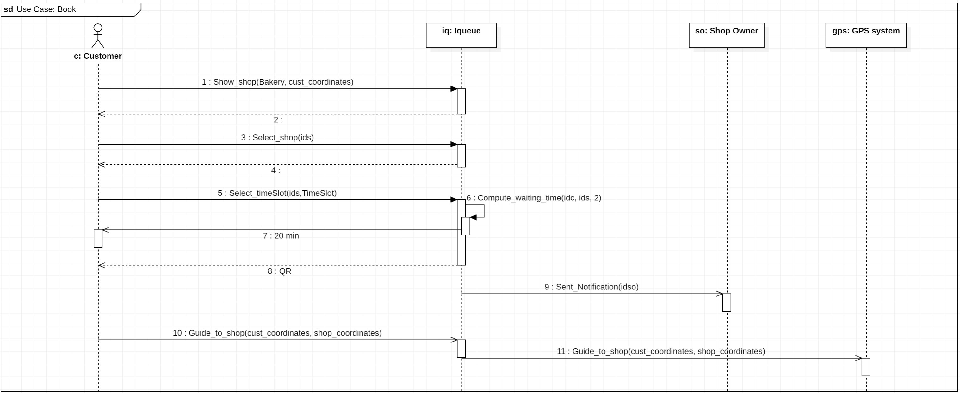
UML requirement – Sequence Diagrams
𝙸𝚚𝚞𝚎𝚞𝚎
Book Sequence Diagrams
Giacomelli, Gottardini, Veronese

Slide 38
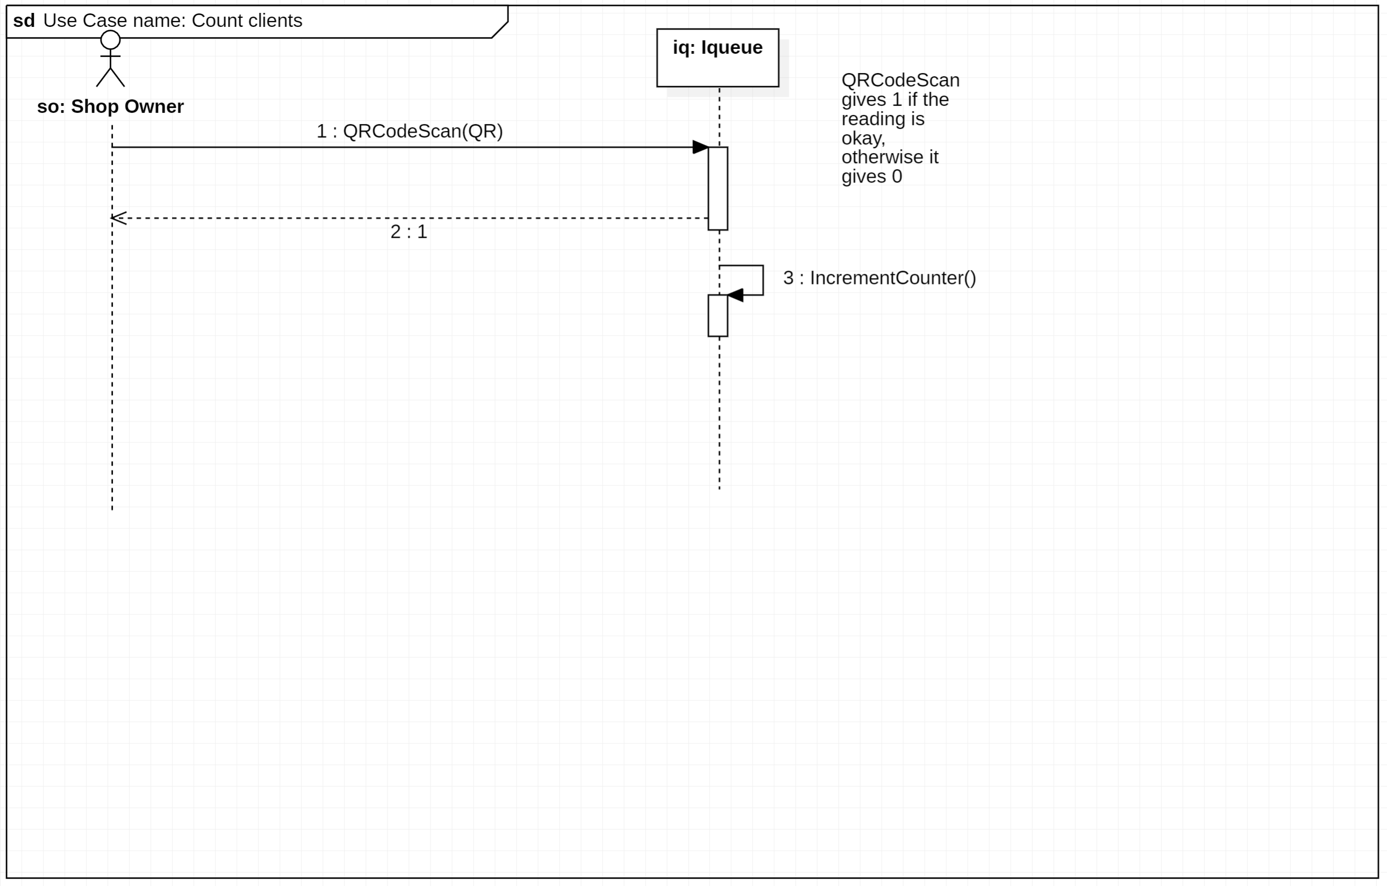
UML requirement – Sequence Diagrams
𝙸𝚚𝚞𝚎𝚞𝚎
Count client Sequence Diagrams
Giacomelli, Gottardini, Veronese

Slide 39
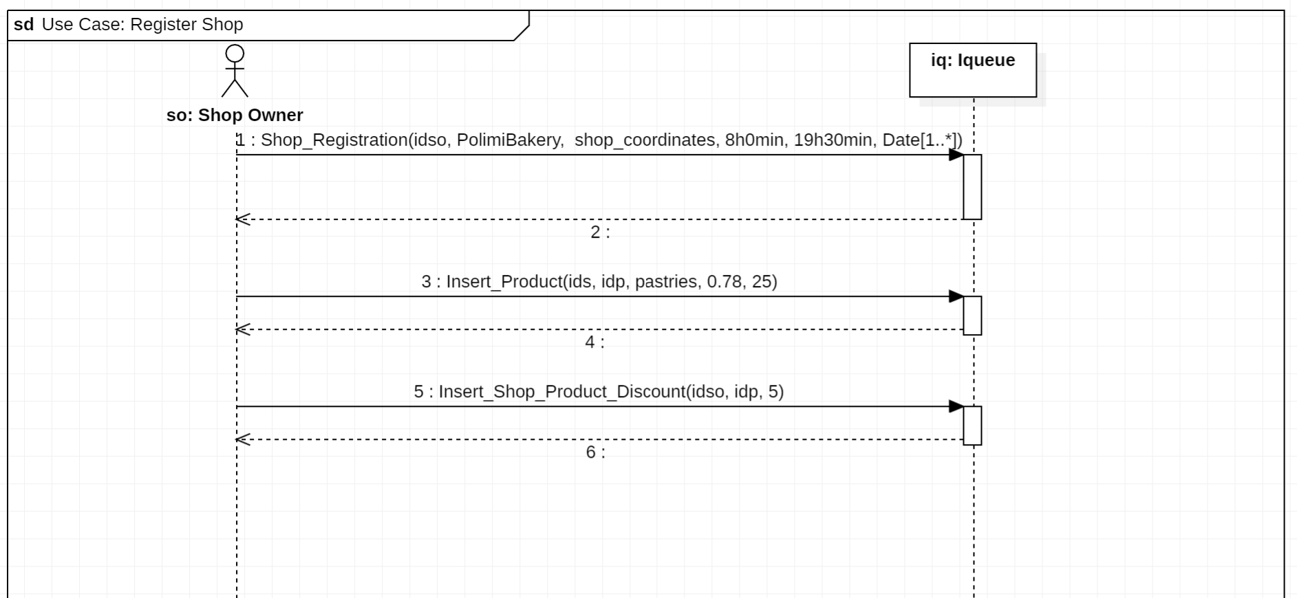
UML requirement – Sequence Diagrams
𝙸𝚚𝚞𝚎𝚞𝚎
Register shop - Sequence Diagrams
Giacomelli, Gottardini, Veronese

Slide 40
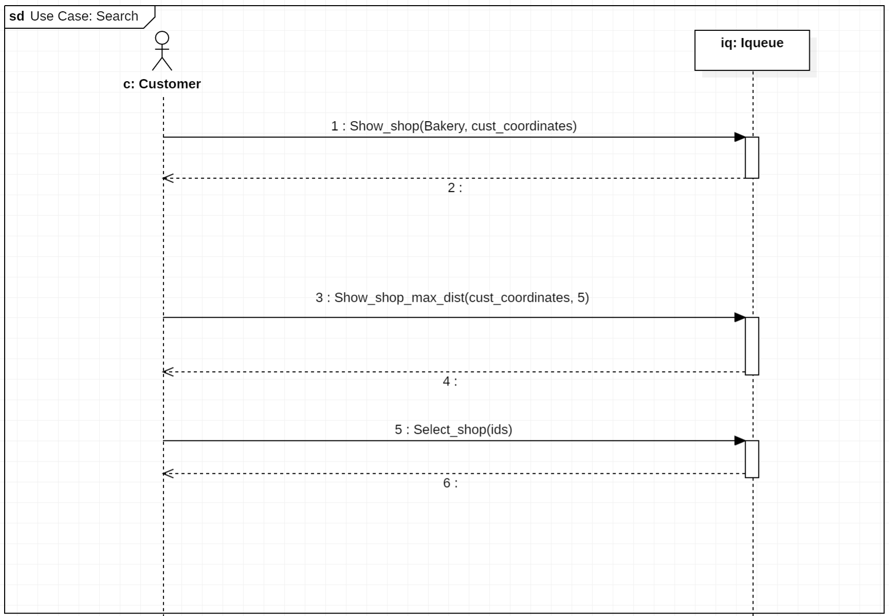
UML requirement – Sequence Diagrams
𝙸𝚚𝚞𝚎𝚞𝚎
Search - Sequence Diagrams
Giacomelli, Gottardini, Veronese

Slide 41
Design analysis
𝙸𝚚𝚞𝚎𝚞𝚎
𝙸𝚚𝚞𝚎𝚞𝚎
Giacomelli, Gottardini, Veronese

Slide 42
Content
𝙸𝚚𝚞𝚎𝚞𝚎
1. Feasibility study
2. Requirement analysis
3. Design analysis
4. Implementation
5. Testing
UML requirements
UML architectural
Giacomelli, Gottardini, Veronese

Slide 43
UML architectural
𝙸𝚚𝚞𝚎𝚞𝚎
The architectural UML has the goal of describing the relationships among the different actors in terms of the internal software components. This means that the Iqueue app will be divided into modules, each one with its own functionalities and which communicate with other components through interfaces.
Components
Interfaces
Sequence diagrams
Giacomelli, Gottardini, Veronese

Slide 44
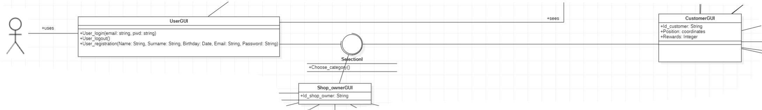
UML architectural - Components
𝙸𝚚𝚞𝚎𝚞𝚎
Components
UserGUI:
graphic interface for the User
methods User_login, User_logout and User_registration
Shop_OwnerGUI:
Connected to Shop Owner and Iqueue
Characterized QRid
CustomerGUI:
graphic interface for the customer
Characterized by idc, position, rewards
Giacomelli, Gottardini, Veronese

Slide 45
UML architectural - Interfaces
𝙸𝚚𝚞𝚎𝚞𝚎
Interfaces
Giacomelli, Gottardini, Veronese

Slide 46
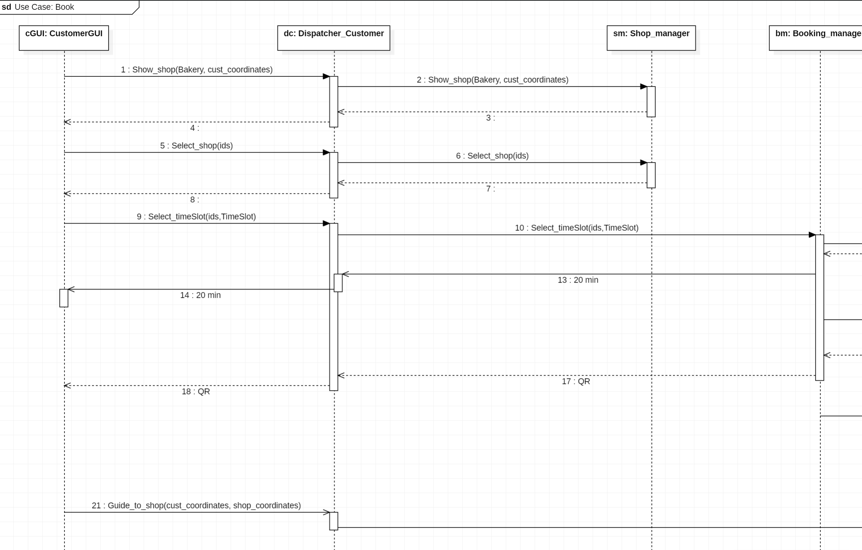
UML requirement – Sequence Diagrams
𝙸𝚚𝚞𝚎𝚞𝚎
Book Sequence Diagrams
PT. 1
Giacomelli, Gottardini, Veronese

Slide 47
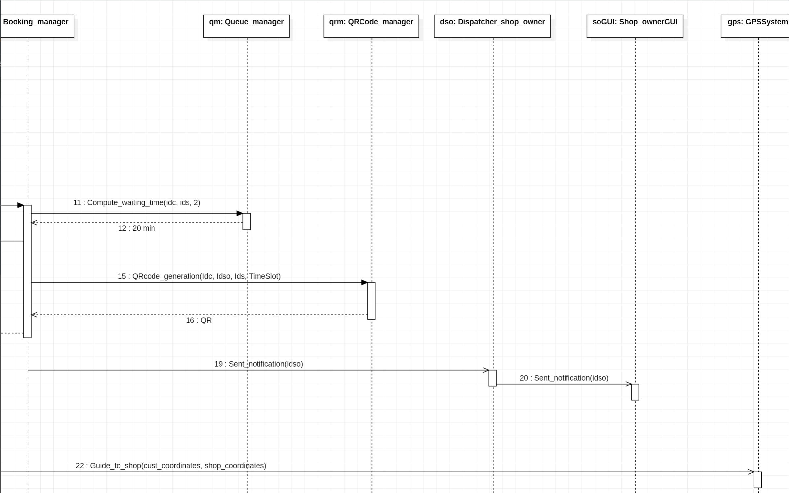
UML requirement – Sequence Diagrams
𝙸𝚚𝚞𝚎𝚞𝚎
Book Sequence Diagrams
PT. 2
Giacomelli, Gottardini, Veronese

Slide 48
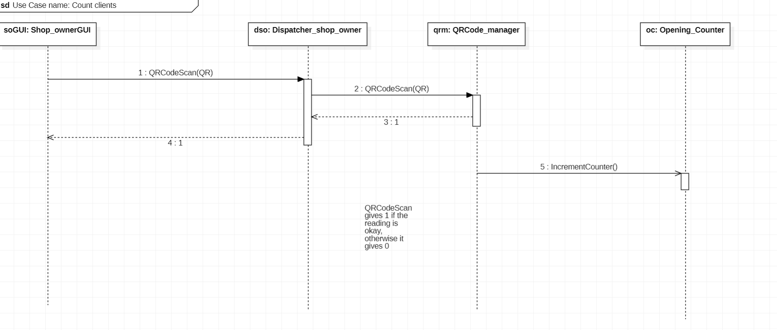
UML requirement – Sequence Diagrams
𝙸𝚚𝚞𝚎𝚞𝚎
Count client Sequence Diagrams
Giacomelli, Gottardini, Veronese

Slide 49
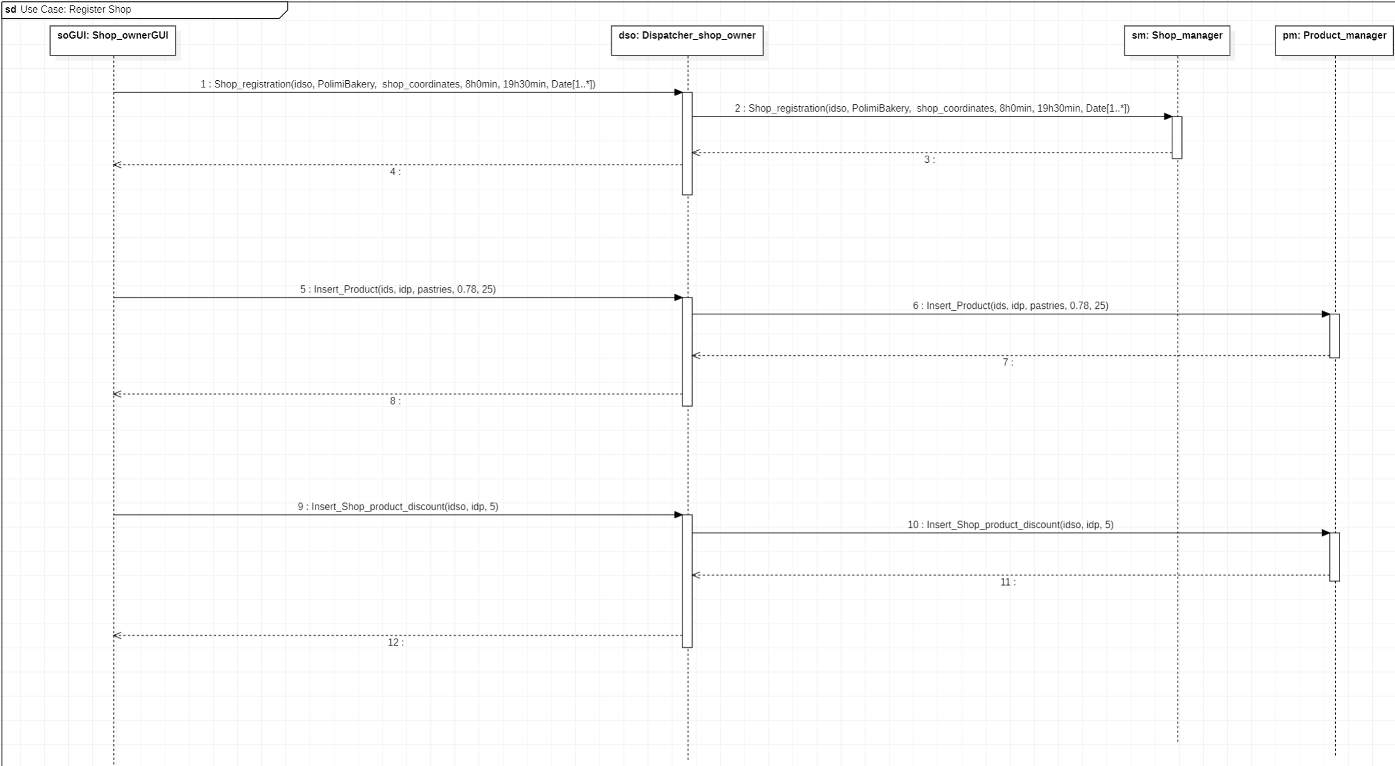
UML requirement – Sequence Diagrams
𝙸𝚚𝚞𝚎𝚞𝚎
Register shop - Sequence Diagrams
Giacomelli, Gottardini, Veronese

Slide 50
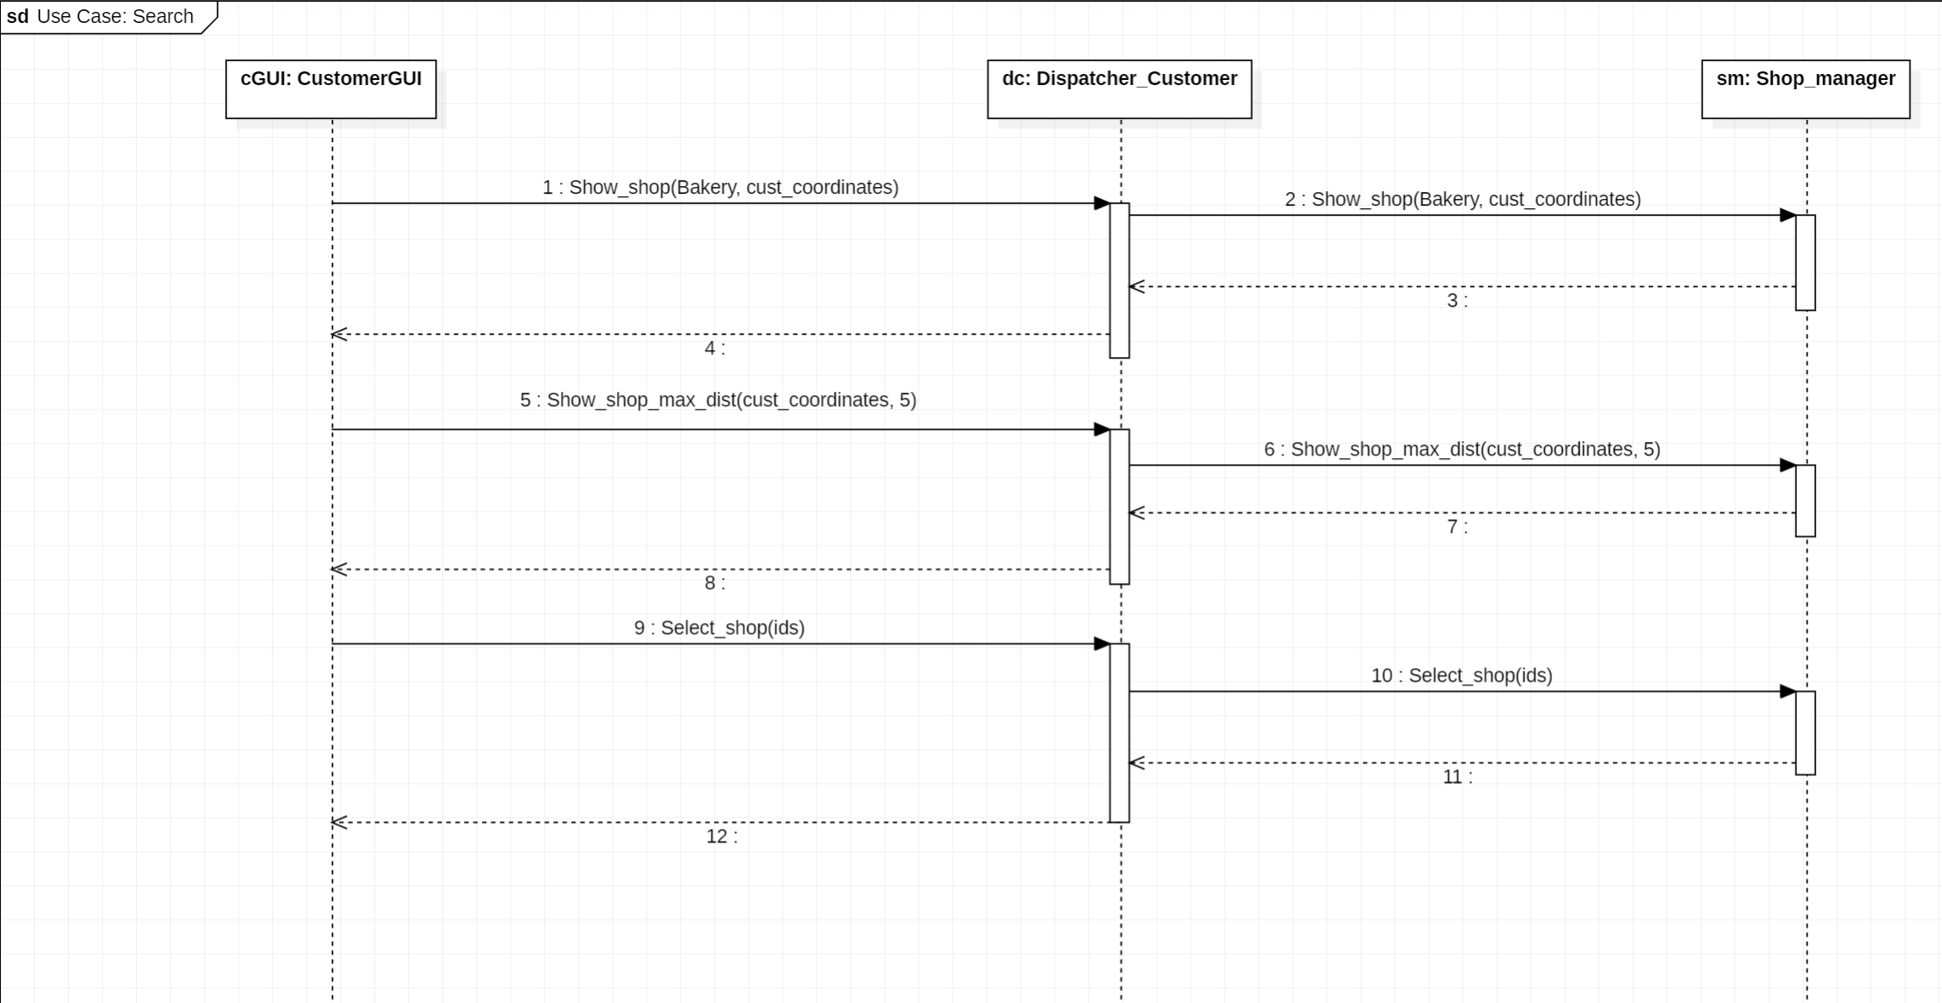
UML requirement – Sequence Diagrams
𝙸𝚚𝚞𝚎𝚞𝚎
Search - Sequence Diagrams
Giacomelli, Gottardini, Veronese

